Slide 1


CAREER CRAFTER
CMR COLLEGE OF ENGINEERING & TECHNOLOGY
(Autonomous)
Kandlakoya, Medchal, HYDERABAD
CENTRE FOR ENGINEERING EDUCATION RESEARCH
REVIEW-II
SOCIAL INNOVATION IN PRACTICE (A400507)
III SEMESTER A.Y 2023-24
Student Team Details
Darshan S Kagi - 22H51A6676
K.Durgaram - 22H51A6695
P.Sharath kumar- 22H51A66B6
Varnika pandey- 22H51A66C6
Y.Nikhitha- 22H51A66C8
J.Krishnapriya-23H55A6610
Faculty Mentors
1. G.Karthik reddy Asst. Prof CEER/ECE
2. K.Raju, Asst. Prof CEER/ECE
3. B.Bala Krishna, Asst. Prof CEER/EEE
Career crafter CMR College of Engineering & Technology

Slide 2

CONTENT
Problem Statement
Existing Solutions
Gaps in Existing Solutions
Proposed Solution
Software required
Block Diagram
Flow Chart
Working Principle of all the software used
Working of the application
Results and Conclusions

Slide 3


PROBLEM STATEMENT
The process of preparing for interviews is often challenging and requires significant dedication and effort. Despite the availability of numerous resources, there is a lack of a centralized, efficient, and effective platform that can aid in this preparation process. The need for a comprehensive tool that provides a wide range of interview questions and answers, caters to various skill levels, and enhances the learning process is evident.
Career crafter CMR College of Engineering & Technology

Slide 4


EXISTING SOLUTIONS
This app gives you all the required insights into the company such as the latest job listings, company reviews, interview experiences, and even salary reports.
This simplifies your search, so you can apply for jobs with confidence. Filter millions of jobs and ratings, talk to professionals, and get smart on salary—then apply with ease.
CV Builder is a tool that allows you to create a resume to look for a job in a much more professional way. The application has more than 100 different templates and formats, allowing you to choose the one that best suits your needs.
Career crafter CMR College of Engineering & Technology

Slide 5

EXISTING SOLUTIONS
IndiaBIX is a popular website among students. It has extremely helpful content for aptitude preparation. Students preparing for government entrance exams will find relevant content on IndiaBIX. IndiaBIX has sections on General Aptitude, Verbal and Logical Reasoning, Current Affairs, General Knowledge, Puzzles, etc.
Career crafter CMR College of Engineering & Technology

Slide 6
GAPS IN EXISTING SOLUTIONS
Glassdoor: While Glassdoor provides valuable insights into companies and job listings, it does not offer personalized interview preparation resources. Users may have to sift through a lot of information to find relevant interview experiences.
CV Engineer: This app focuses on resume creation but does not provide comprehensive interview preparation resources. It lacks features like mock interviews, aptitude tests, or a repository of potential interview questions.
Indiabix: While Indiabix provides aptitude tests and interview preparation resources, it may not offer personalized learning experiences or company-specific interview preparation. It also lacks features like resume building or professional networking.
Career crafter CMR College of Engineering & Technology

Slide 7
PROPOSED SOLUTION
The app I developed is a comprehensive solution for students preparing for software interviews. It covers various aspects:
Problem Topics
Problem Difficulty
Company wise
HR Questions
Data Science
Aptitude
Resume
Company Principle
Interview Etiquette
Join Community
Communicate
Iterate
Career crafter CMR College of Engineering & Technology

Slide 8
SOFTWARE REQUIRED
1. Laptop
2. Android Studio
3. Flutter
4. Google Play Console
5. Figma
Career crafter CMR College of Engineering & Technology

Slide 9
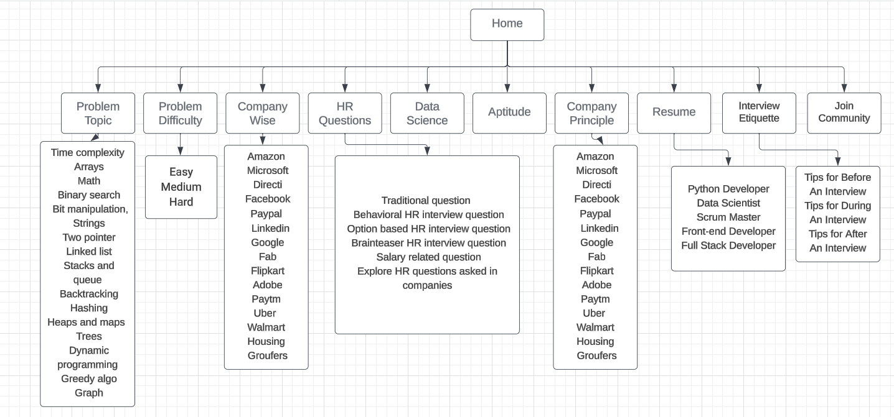
BLOCK DIAGRAM
Career crafter CMR College of Engineering & Technology

Slide 10
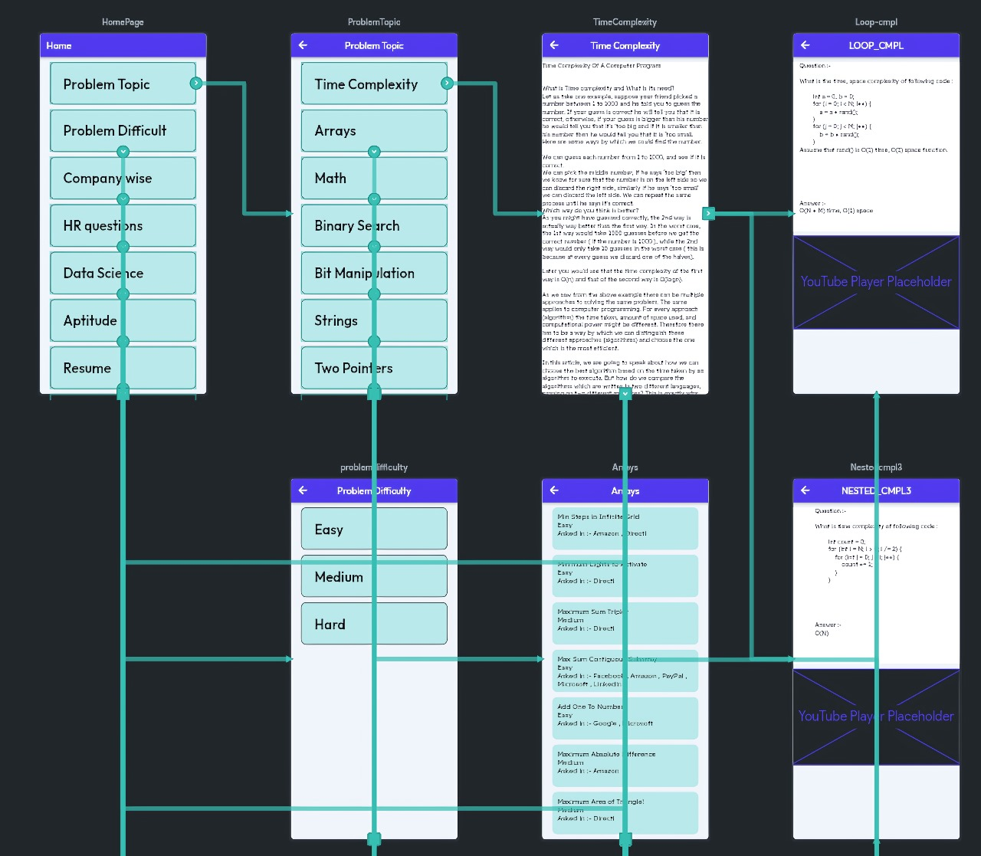
FLOW CHART
Career crafter CMR College of Engineering & Technology

Slide 11
WORKING OF THE MODEL
(STEP WISE EXECUTION)
1. Research and Compile Questions:
Collect relevant questions from the internet to inform the content of the app.
2. Design Logo and Splash Screen:
Create visually appealing and distinctive logo and splash screen designs for the app.
3. Storyboard Development:
Construct a comprehensive storyboard using Figma to outline the user interface and user experience.
4. App Development using Flutter:
Utilize the Flutter framework to develop the app, referencing the storyboard created in Figma as a guide.
Career crafter CMR College of Engineering & Technology

Slide 12
WORKING OF THE MODEL
(STEP WISE EXECUTION)
5. Error Checking:
Thoroughly review and debug the app, ensuring it is free from errors and glitches.
6. Google Play Console Setup:
Purchase and set up Google Play Console to facilitate the deployment of the app on the Google Play Store.
7. App Deployment:
Deploy the app on the Google Play Store using the configured Google Play Console.
Career crafter CMR College of Engineering & Technology

Slide 13
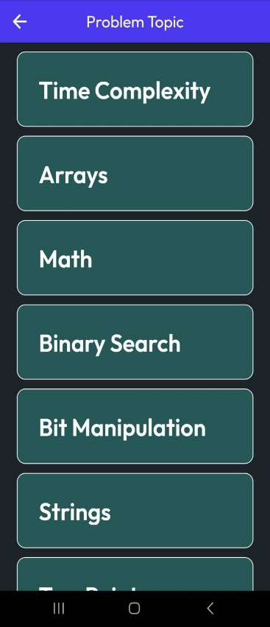
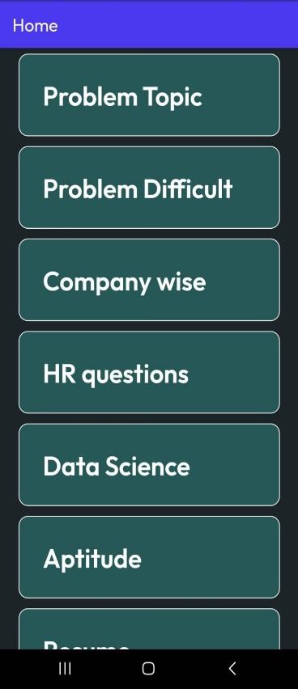
PROTOTYPE MODEL
Career crafter CMR College of Engineering & Technology

Slide 14
RESULTS AND DISCUSSIONS
The software interview preparation app has delivered positive outcomes, providing a strong platform for students preparing for technical job interviews. Packed with features to enhance learning, it covers both technical and soft skills, encourages community engagement, and minimizes distractions. Continuous updates and user feedback will boost its impact in the competitive field of interview preparation resources.
Career crafter CMR College of Engineering & Technology

Slide 15
ADVANTAGES & DISADVANTAGES
ADVANTAGES
Potential Lack of Real-time Updates
Static Resume Templates
Language Barrier
Comprehensive Coverage
Tailored Difficulty Levels
Company-Specific Preparation
HR Interview Preparation
Diverse Skill Set Enhancement
Community Engagement
Multimedia Learning
Distraction-Free Learning
Offline learning
DISADVANTAGES
Career crafter CMR College of Engineering & Technology

Slide 16
CONCLUSION
To sum up, my app is a comprehensive tool for students preparing for software interviews. It covers various topics, difficulty levels, and company-specific questions, providing solutions in code and video formats. The app addresses technical and soft skills, including data science, aptitude, resume building, company principles, interview etiquette, and a community forum for discussion. I believe this app will be a valuable resource for students aspiring to succeed in software interviews and beyond.
Career crafter CMR College of Engineering & Technology

Slide 17
REFERENCES
https://prepinsta.com/best-website-for-placement-preparation/#:~:text=IndiaBIX%20is%20a%20popular%20website,General%20Knowledge%2C%20Puzzles%2C%20etc
https://www.techtarget.com/whatis/definition/LinkedIn
Career crafter CMR College of Engineering & Technology

Slide 18


Slide 19

Questions…..

